Slide 1
Review of Lipoprotein Metabolism

Slide 2
Fat metabolism during well fed state

Slide 3
Fat metabolism during fasting state

Slide 4
Overview of atheroma formation

Slide 5
Diagrammatic representation of Atheroma formation
Stage I, the initiation of the plaque, is characterized by modulation of endothelial cell (EC) constitutive functions due to increased concentrations of plasma low density lipoproteins (LDL), or C-reactive Protein (CRP) and tumor necrosis factor (TNF-a).
Stage II, LDL trapped within the intima undergo alterations (oxidation, glycation), turning into modified lipoproteins (MLp). They induce EC dysfunction, expressed by the appearance of new cell adhesion molecules and chemotactic factors.
Stage III, This is followed by a robust inflammatory reaction in which plasma monocytes (Mon) assisted by platelets (Pl), T lymphocytes (TLy) and dendritic cells (Dc) adhere and enter the arterial intima. Monocytes become activated macrophages (Mac) that express scavenger receptors, take up MLp and progressively turn into macrophage derived foam cells (FC) characteristic for the fatty streak.
Stage IV, Smooth muscle cells (SMC) glide from the media into the intima forming the fibrous cap.
Stage V, The fibrolipid plaque comprising SMC-, Mac- and EC-derived foam cells is visible in this stage. Extracellular matrix (ECM), cholesterol crystals (cc) and large calcification cores (Ca) are formed.
The complicated plaque becomes vulnerable, exhibiting fibrous cap thinning and excess inflammatory cytokines that leads to stage VI.

Slide 6
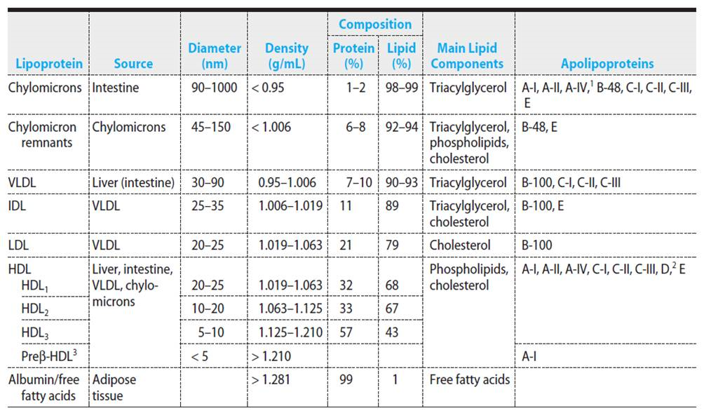
Serum lipids

Slide 7
Overview of Lipoprotein Metabolism

Slide 8
Predicting atherogenic risk
Assessment of plasma concentrations of lipids; TAG and Cholesterol
Assessment of lipid transporting lipoprotein; LDL-C, HDL-C and TAG
CVD is closely associated with high LDL– C / HDL – C or hyper TG
Atherogenic Index of Plasma (AIP); Log (TG / HDL – C)
This is more precise prediction when compared to the other indexes.

Slide 9
Prediction based on lipid profile

Slide 10
Novel lipoprotein markers
Lipoprotein-associated phospholipase A₂ :(Lp-PLA₂)
Sensitive cardiac marker, specifically binds with LDL and hydrolyze the molecule triggering atherogenic changes.
Lipoprotein(a) ; Lp(a)
Structural analog of LDL, shows anti-fibrinolytic activity and higher tendency of deposition on vascular endothelium

Slide 11
Thank you

